Slide 1
Diffusion Models for Image Generation
2022-6-24, by Huang Mengqi

Slide 2
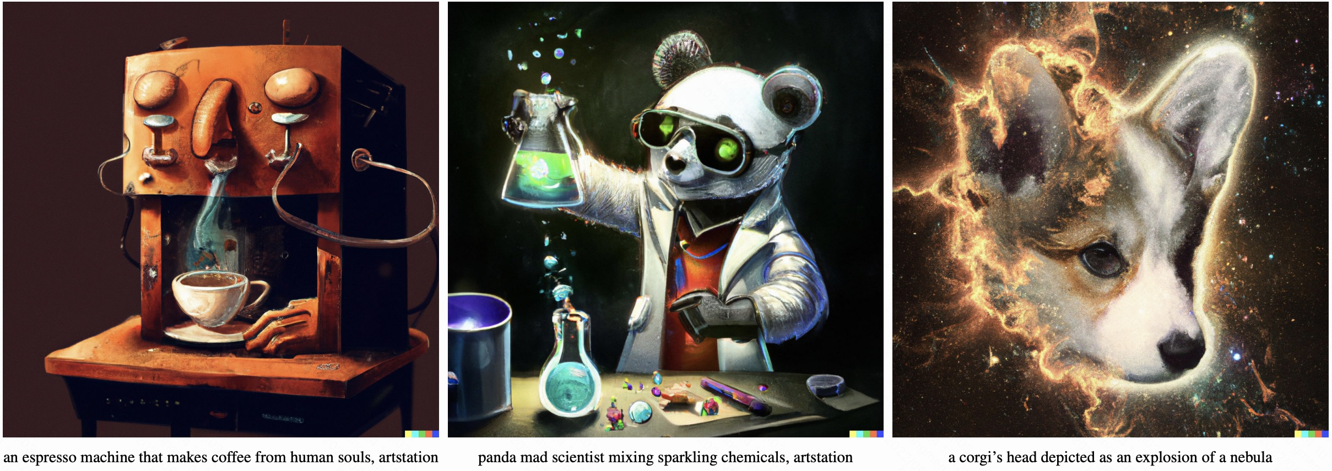
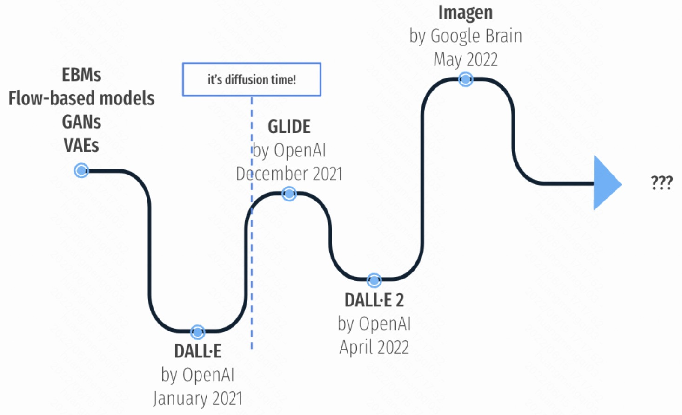
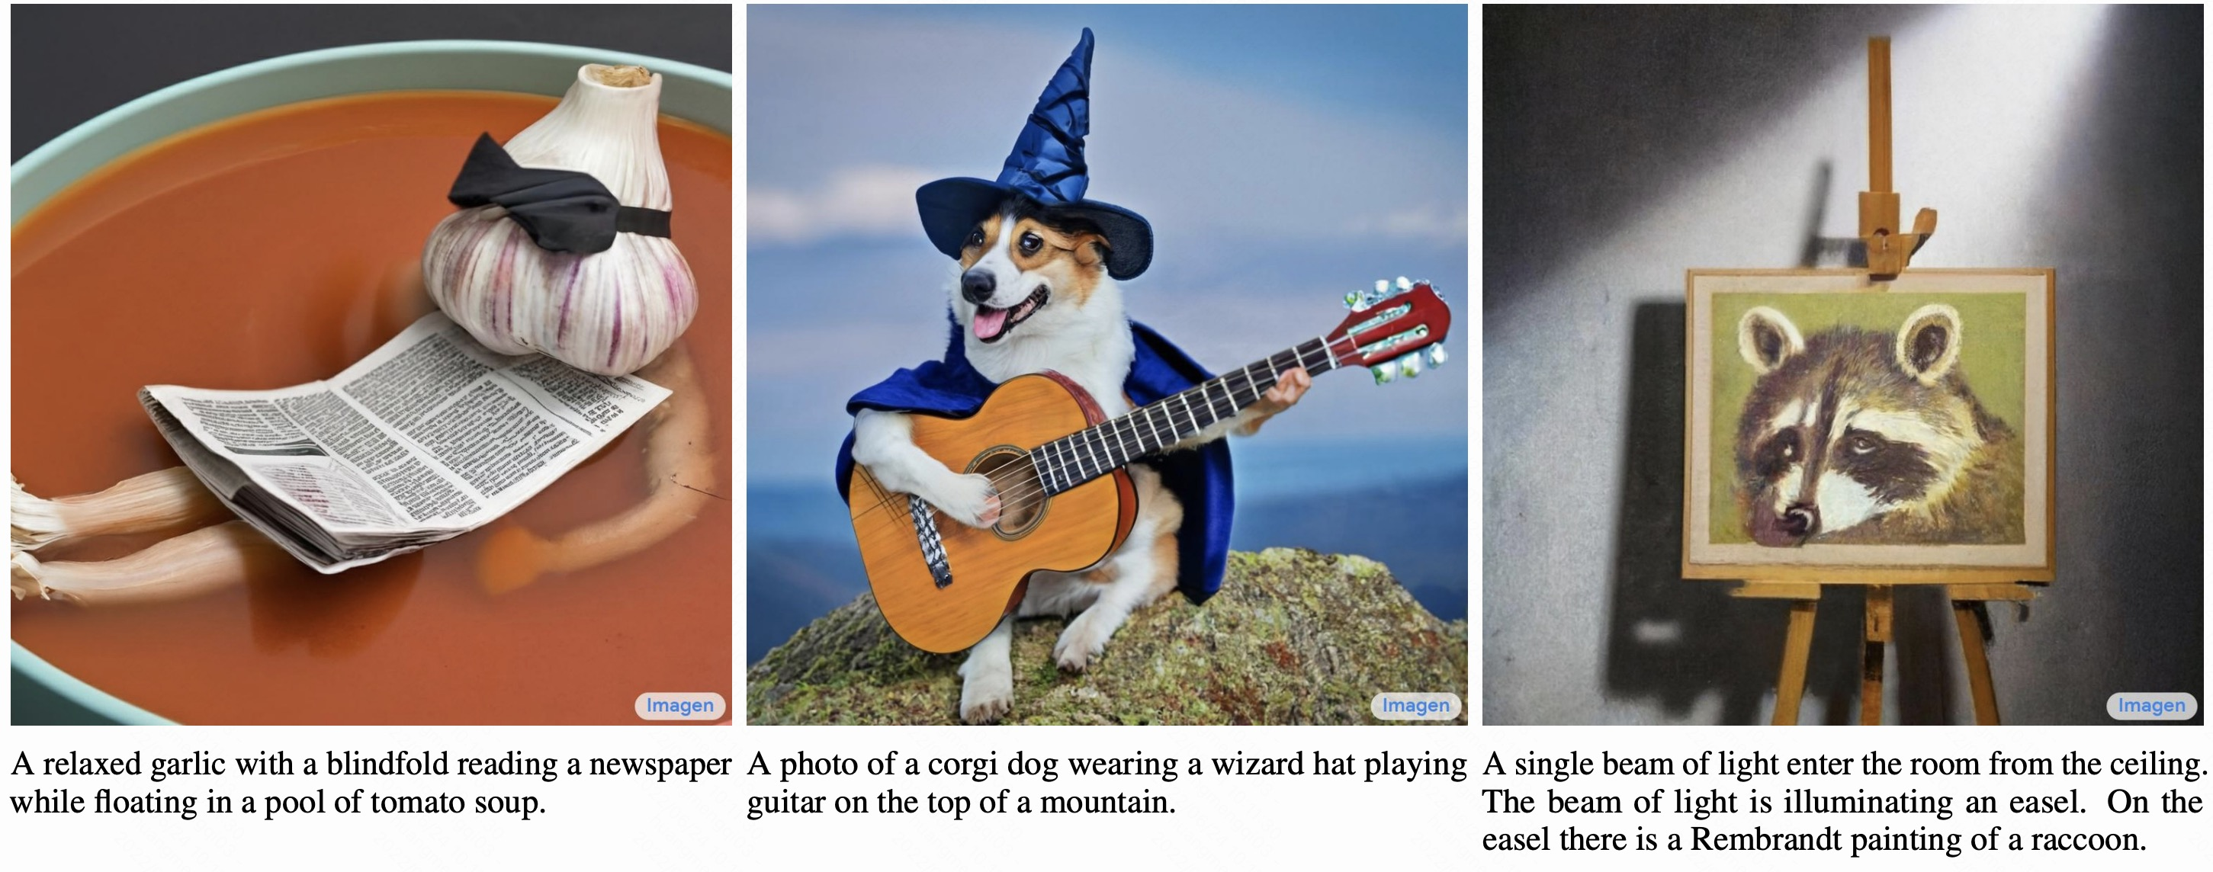
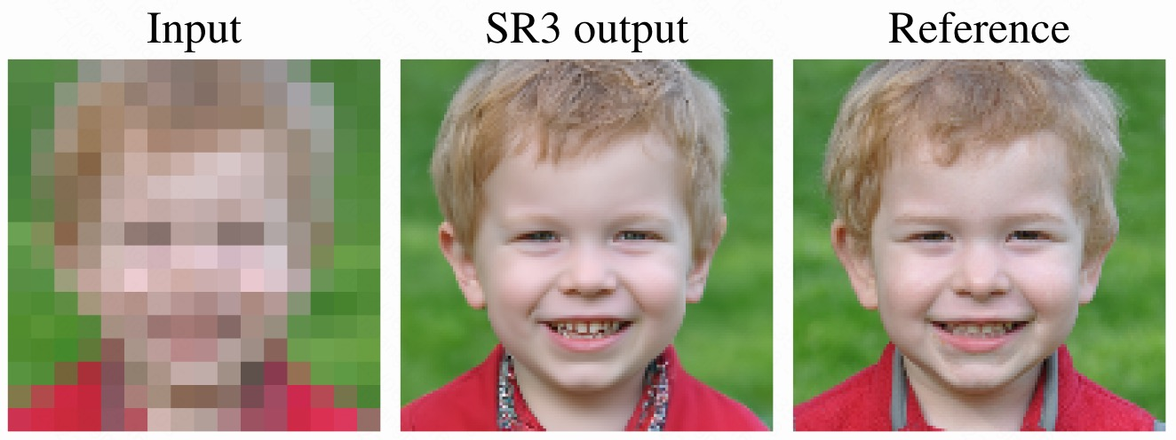
Short timeline of image generation and text-to-image solutions
Amazing results on various tasks !

Slide 3
Reference
Denoising Diffusion Probabilistic Models, Jonathan Ho, Ajay Jain, Pieter Abbeel, NeurIPS 2020.
Denoising Diffusion Implicit Models, Jiaming Song, Chenlin Meng, Stefano Ermon, ICLR 2021.
Improved Denoising Diffusion Probabilistic Models, Alex Nichol, Prafulla Dhariwal, ICLR 2021.
Diffusion Models Beat GANs on Image Synthesis, Prafulla Dhariwal¹, Alex Nichol , NIPS 2021.
Image Super-Resolution via Iterative Refinement, Chitwan Saharia, Jonathan Ho, William Chan, Tim Salimans, David J. Fleet, Mohammad Norouzi
Gotta Go Fast When Generating Data with Score-Based Models，Alexia Jolicoeur-Martineau, Ke Li, Rémi Piché-Taillefer, Tal Kachman, Ioannis Mitliagkas
Cascaded Diffusion Models for High Fidelity Image Generation，Jonathan Ho¹, Chitwan Saharia¹, William Chan, David J. Fleet, Mohammad Norouzi, Tim Salimans
Learning to Efficiently Sample from Diffusion Probabilistic Models，Daniel Watson, Jonathan Ho, Mohammad Norouzi, William Chan
Score-based Generative Modeling in Latent Space，Arash Vahdat¹, Karsten Kreis¹, Jan Kautz
D2C: Diffusion-Denoising Models for Few-shot Conditional Generation，Abhishek Sinha¹, Jiaming Song¹, Chenlin Meng, Stefano Ermon
Variational Diffusion Models，Diederik P. Kingma¹, Tim Salimans¹, Ben Poole, Jonathan Ho
Structured Denoising Diffusion Models in Discrete State-Spaces，Jacob Austin¹, Daniel D. Johnson¹, Jonathan Ho, Daniel Tarlow, Rianne van den Berg
ILVR: Conditioning Method for Denoising Diffusion Probabilistic Models，Jooyoung Choi, Sungwon Kim, Yonghyun Jeong, Youngjune Gwon, Sungroh Yoon，ICCV 2021 (Oral).

Slide 4
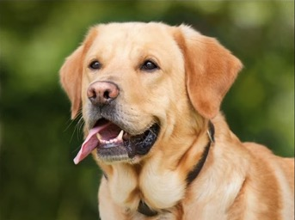
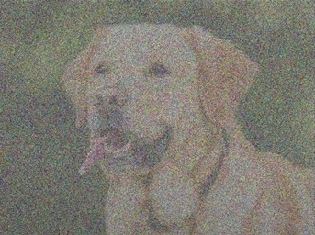

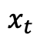
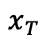
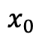
What are diffusion models?
Basic concept:
forward process
reverse process
？
？
$$x_{0}$$
$$x_{t}$$
$$x_{T}$$
Notes:
对于一张图像x_0，如果我们给它添加一定的高斯噪声，那么我们会得到一张带噪的图像x_t，如果我们不断重复这一过程，那么我们最终会得到一张完全的高斯噪声图像x_T。那么，如果我们有一种方法能将上述逐步添加噪声的过程反向，即从高斯噪声中逐步去除噪声信息，那么我们就得到了一个生成模型，即diffusion model。

Slide 5
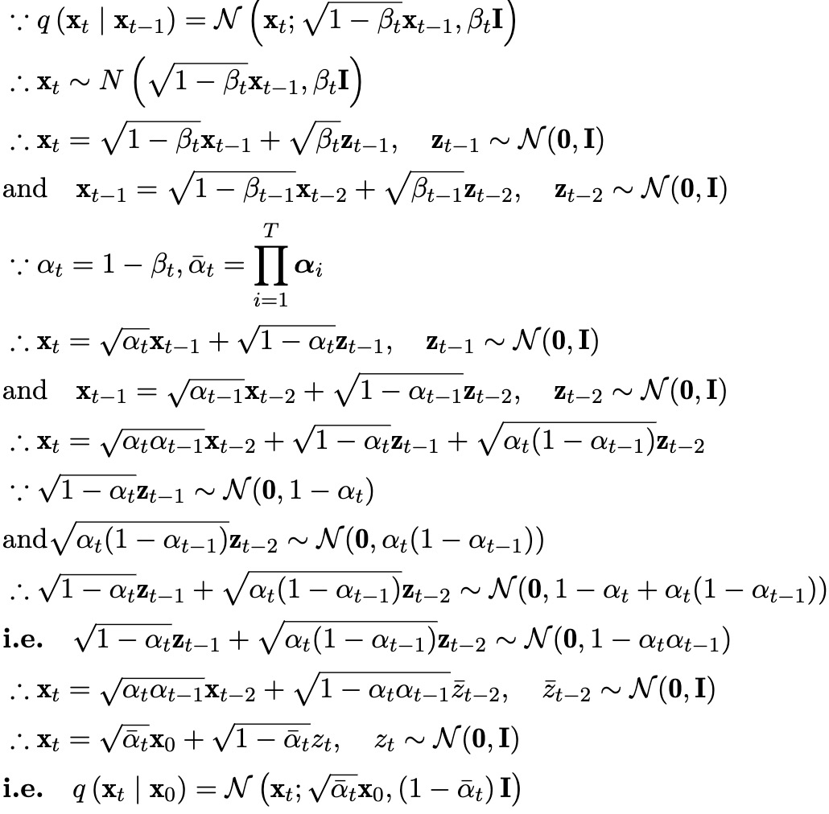
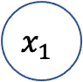
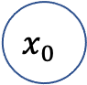
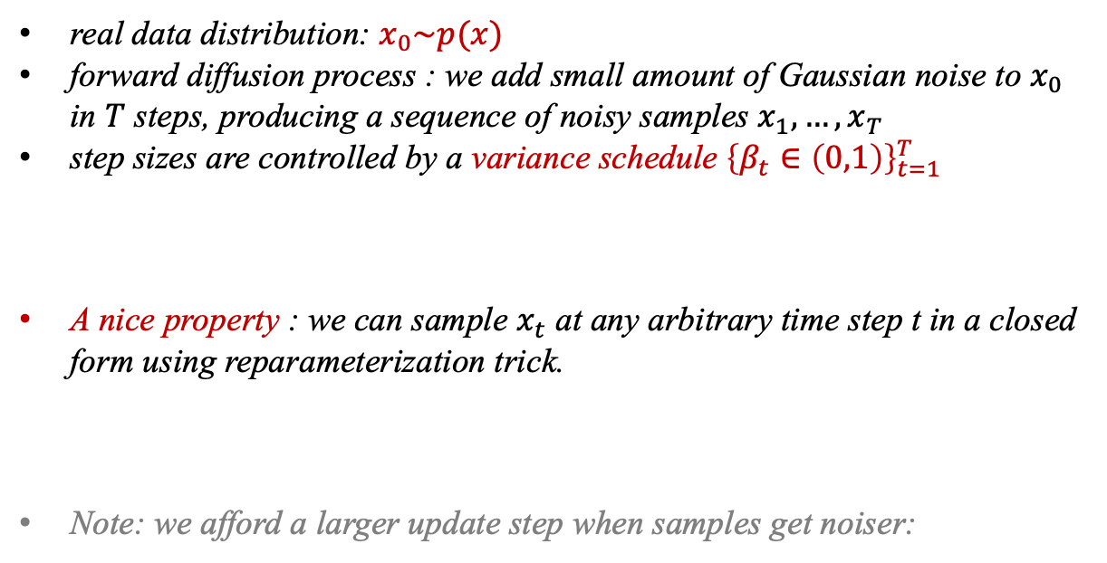
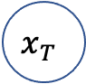
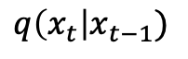
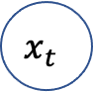
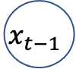
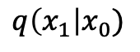
What are diffusion models?
forward (diffusion) process : fixed Markov chain
$$x_{0}$$
$$q\left(x_{1}\right|x_{0})$$
$$x_{1}$$
$$x_{t−1}$$
$$q\left(x_{t}\right|x_{t−1})$$
$$x_{t}$$
$$x_{T}$$
(1) + (2) $→$ (3):
…
…
real data distribution: $x_{0}\sim p(x)$
forward diffusion process : we add small amount of Gaussian noise to $x_{0}$ in $T$ steps, producing a sequence of noisy samples $x_{1}, …, x_{T}$
step sizes are controlled by a variance schedule ${\left\{β_{t}∈\left(0,1\right)\right\}}_{t=1}^{T}$
A nice property : we can sample $x_{t}$ at any arbitrary time step t in a closed form using reparameterization trick.
Note: we afford a larger update step when samples get noiser:
(1)
(2)
(3)

Slide 6
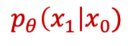
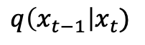
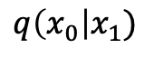
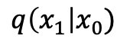
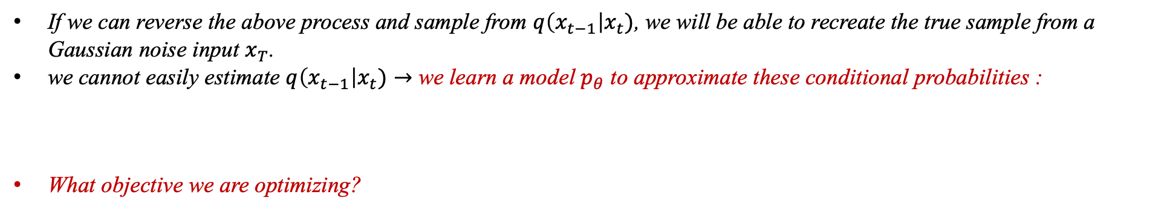
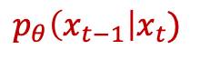
What are diffusion models?
reverse (diffusion) process:
$$x_{0}$$
$$q\left(x_{0}\right|x_{1})$$
$$x_{1}$$
$$x_{t−1}$$
$$q\left(x_{t}\right|x_{t−1})$$
$$x_{t}$$
$$x_{T}$$
…
…
$$q\left(x_{1}\right|x_{0})$$
$$q\left(x_{t−1}\right|x_{t})$$
$$p_{θ}\left(x_{1}\right|x_{0})$$
$$p_{θ}\left(x_{t−1}\right|x_{t})$$
If we can reverse the above process and sample from $q\left(x_{t−1}\right|x_{t})$, we will be able to recreate the true sample from a Gaussian noise input $x_{T}$.
we cannot easily estimate $q\left(x_{t−1}\right|x_{t})→$ we learn a model $p_{θ}$ to approximate these conditional probabilities :
What objective we are optimizing?

Slide 7
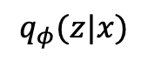
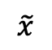
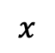
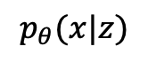
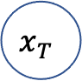
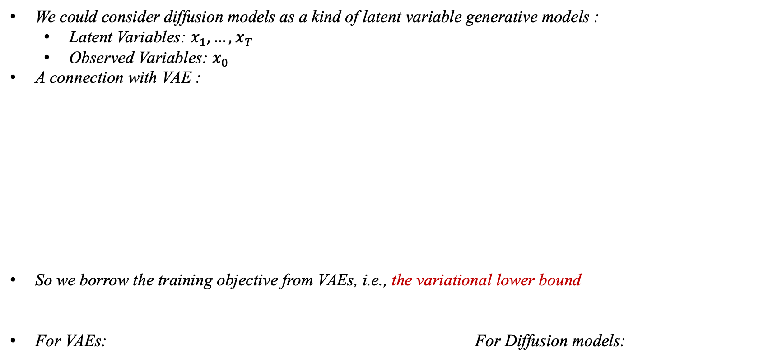
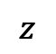
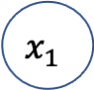
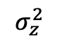
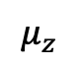
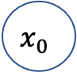
What are diffusion models?
A connection with VAE:
We could consider diffusion models as a kind of latent variable generative models :
Latent Variables: $x_{1}, …, x_{T}$
Observed Variables: $x_{0}$
A connection with VAE :
So we borrow the training objective from VAEs, i.e., the variational lower bound
For VAEs: For Diffusion models:
VAE :
Diffusion model :
$$q_{φ}(z|x)$$
$$p_{θ}(x|z)$$
(fixed) forward “encoding”
$$μ_{z}$$
$$x_{0}$$
$$x_{1}$$
$$x_{T}$$
sample
…
$$x$$
Encoder
$$z$$
Decoder
$$\tilde{x}$$
$$σ_{z}^{2}$$
reverse “decoding”

Slide 8
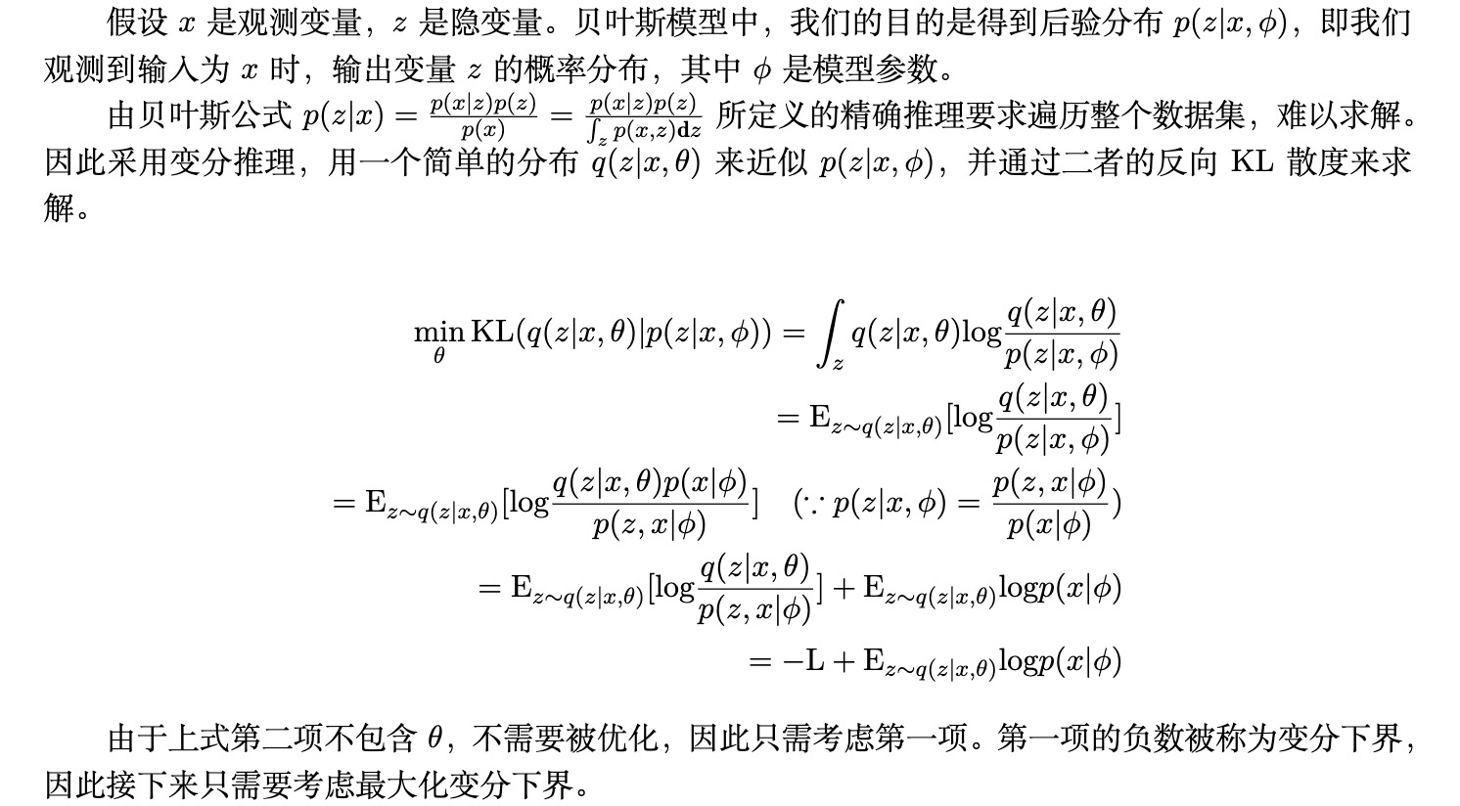
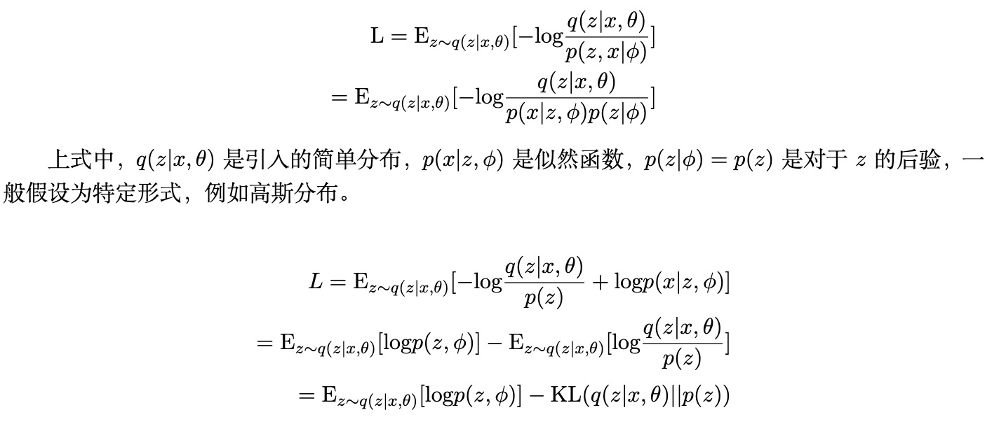
What are diffusion models?
Derivation for the variational lower bound of VAE:

Slide 9
What are diffusion models?
Training objective of reverse (diffusion) process:
We minimize the negative log-likelihood, make some simplification to the variational lower bound :
Considering the property :
Notes:
To decrease the training variance

Slide 10
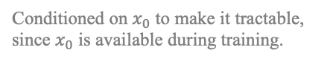
What are diffusion models?
Derivation of the Training objective:
Conditioned on $x_{0}$ to make it tractable, since $x_{0}$ is available during training.

Slide 11
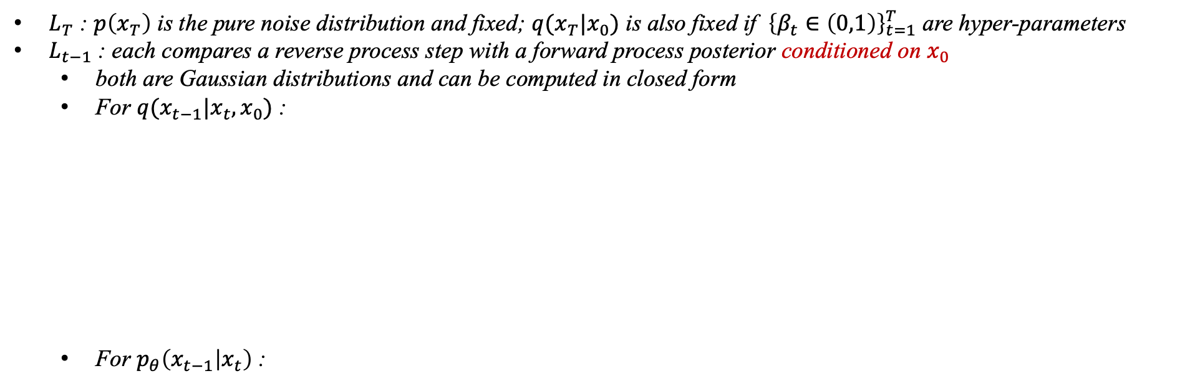
What are diffusion models?
Training objective of reverse (diffusion) process:
$L_{T}$ : $p\left(x_{T}\right)$ is the pure noise distribution and fixed; $q(x_{T}|x_{0})$ is also fixed if ${\left\{β_{t}∈\left(0,1\right)\right\}}_{t=1}^{T}$ are hyper-parameters
$L_{t−1}$ : each compares a reverse process step with a forward process posterior conditioned on $x_{0}$
both are Gaussian distributions and can be computed in closed form
For $q(x_{t−1}|x_{t},x_{0})$ :
For $p_{θ}\left(x_{t−1} | x_{t}\right)$ :
Considering the property :

Slide 12
What are diffusion models?
Derivation of $q(x_{t−1}|x_{t},x_{0})$ :
$Using Bayes′ rule$:
Following the standard Gaussian density function, the mean and variance can be parameterized as follows::

Slide 13
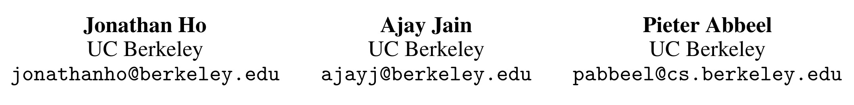
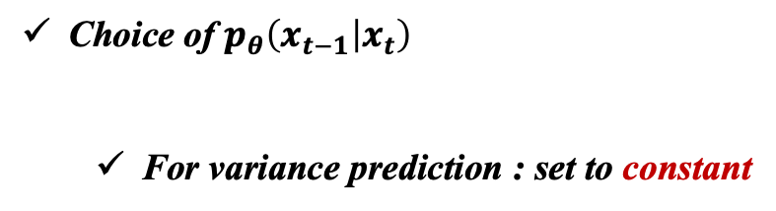
Denoising Diffusion Probabilistic Models
Contribution :
Propose a simplified, reparametrized variational bound objective for diffusion models , and show that diffusion models actually are capable of generating high quality samples
Choice of $p_{θ}\left(x_{t−1} | x_{t}\right)$
For variance prediction : set to constant
super bounds on reverse process entropy
lower bounds on reverse process entropy

Slide 14
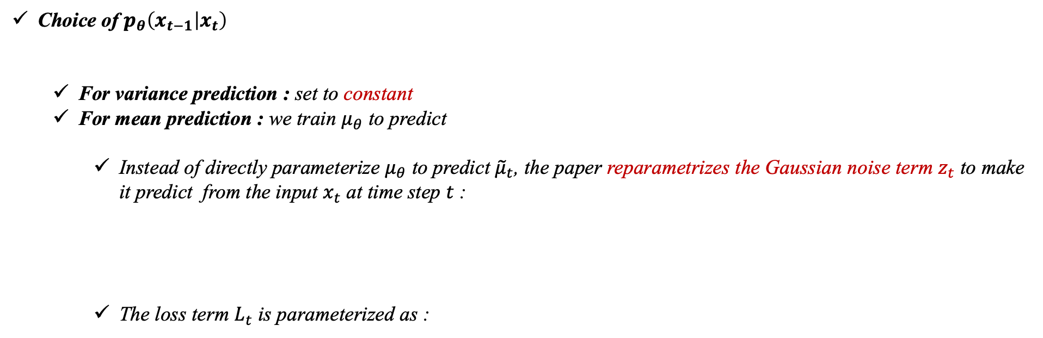
Denoising Diffusion Probabilistic Models
Choice of $p_{θ}\left(x_{t−1} | x_{t}\right)$
For variance prediction : set to constant
For mean prediction : we train $μ_{θ}$ to predict
Instead of directly parameterize $μ_{θ}$ to predict ${\tilde{μ}}_{t}$, the paper reparametrizes the Gaussian noise term $z_{t}$ to make it predict from the input $x_{t}$ at time step $t$ :
The loss term $L_{t}$ is parameterized as :
simplified objective that ignores the weighting term

Slide 15
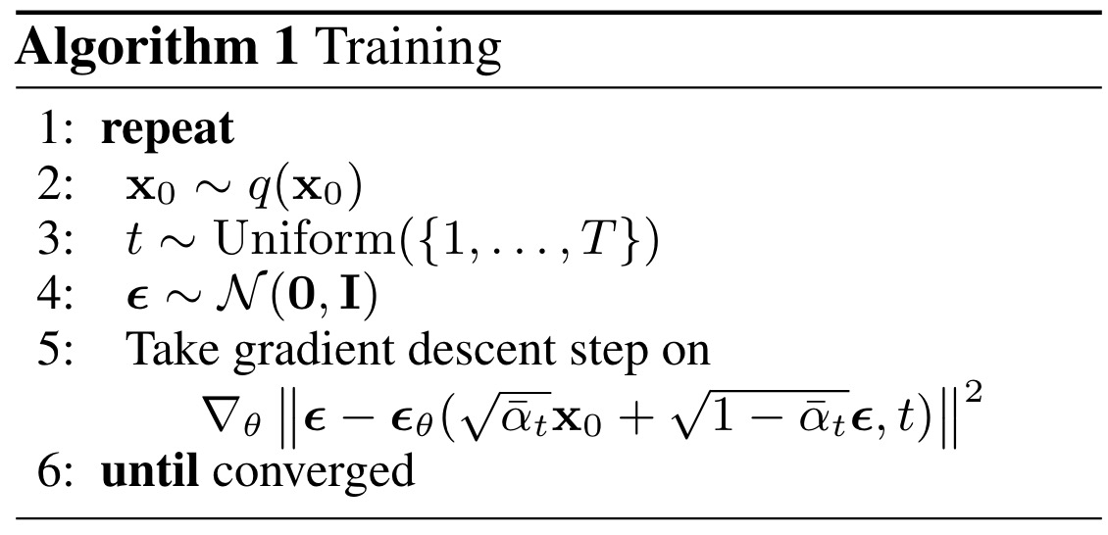
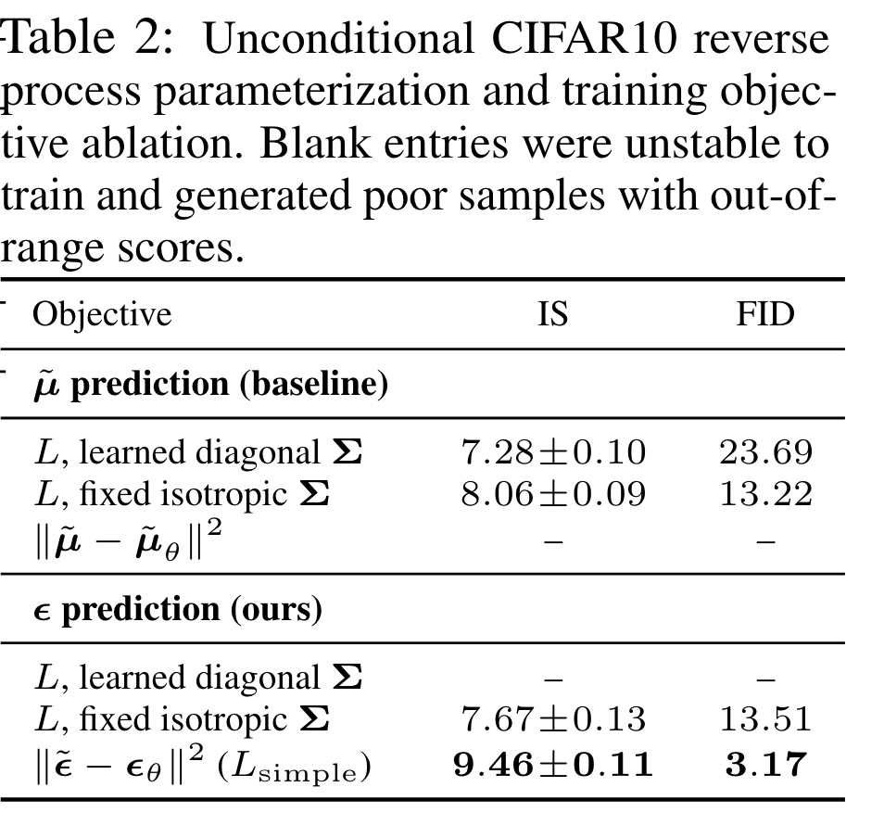
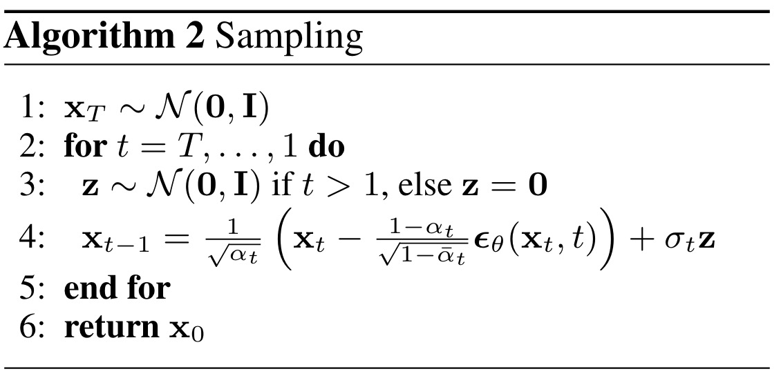
Denoising Diffusion Probabilistic Models

Slide 16
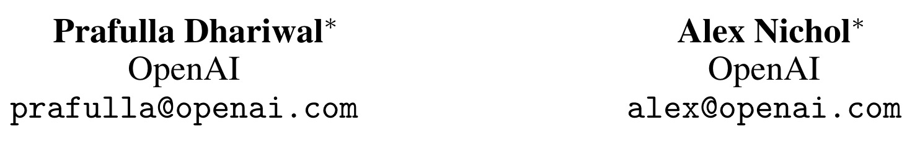
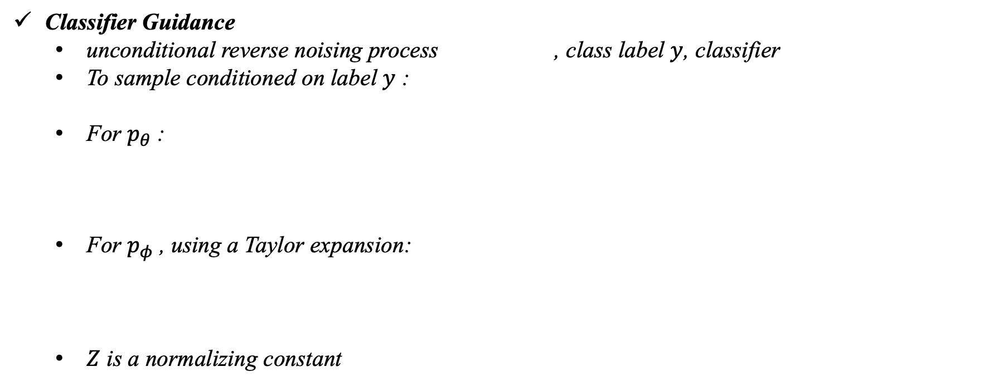
Diffusion Models Beat GANs on Image Synthesis
Motivation (the gap between diffusion models and GANs) & Contribution :
Model Architecture
A scheme for trading off diversity for fidelity
Classifier Guidance
unconditional reverse noising process , class label $y$, classifier
To sample conditioned on label $y$ :
For $p_{θ}$ :
For $p_{φ}$ , using a Taylor expansion:
$Z$ is a normalizing constant

Slide 17
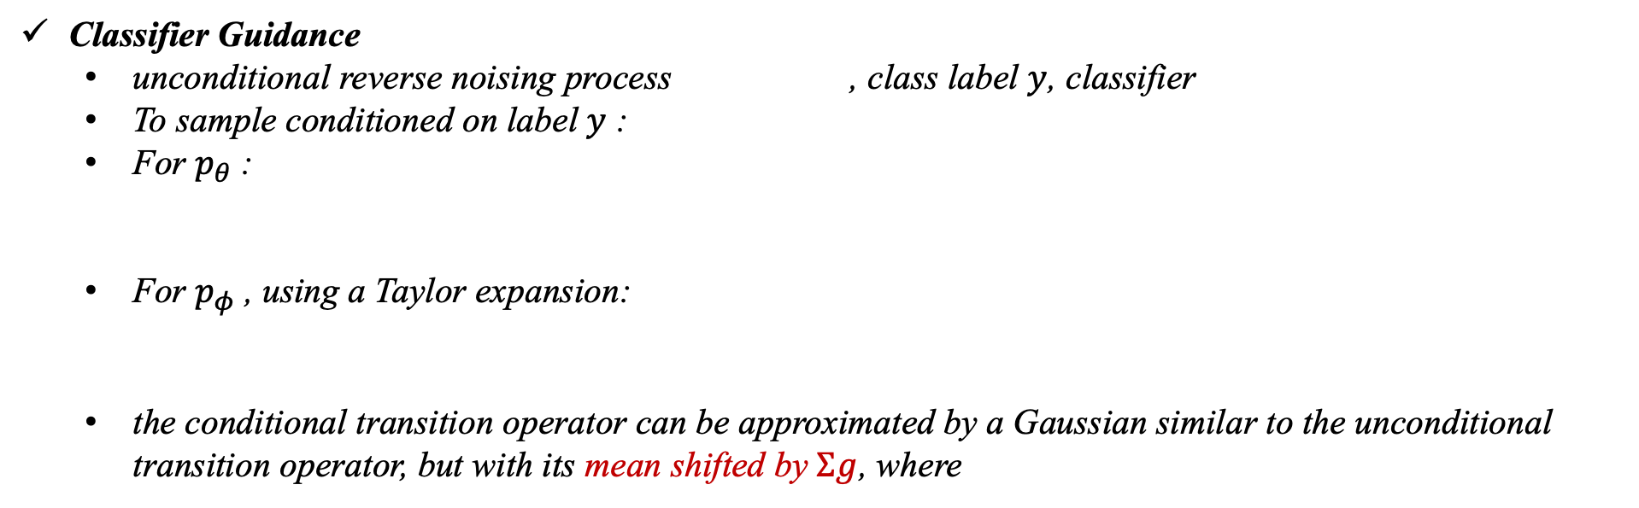
Diffusion Models Beat GANs on Image Synthesis
Classifier Guidance
unconditional reverse noising process , class label $y$, classifier
To sample conditioned on label $y$ :
For $p_{θ}$ :
For $p_{φ}$ , using a Taylor expansion:
the conditional transition operator can be approximated by a Gaussian similar to the unconditional transition operator, but with its mean shifted by $Σg$, where

Slide 18
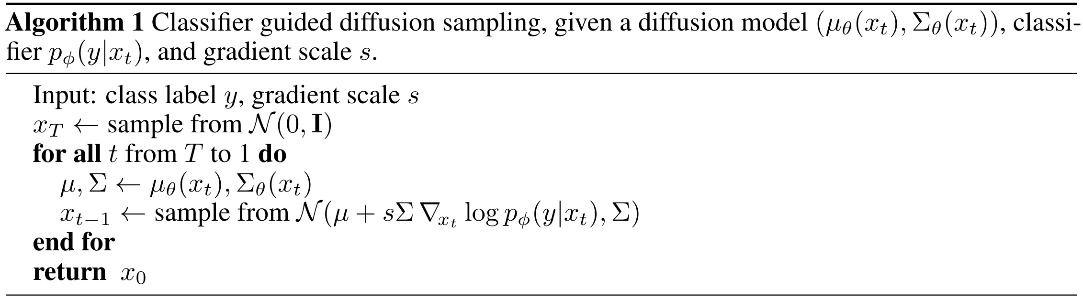
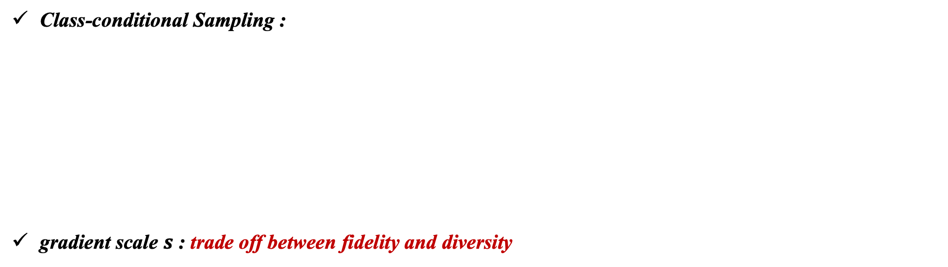

Diffusion Models Beat GANs on Image Synthesis
Class-conditional Sampling :
gradient scale $s$ : trade off between fidelity and diversity
=> $p{\left(y | x\right)}^{s} is sharper than p(y|x)$
a larger gradient scale focuses more on the modes of the classifier, which is potentially desirable for producing higher fidelity (but less diverse) samples.

Slide 19


Diffusion Models Beat GANs on Image Synthesis
trade off between fidelity and diversity

